Slide 1
ACME ChatBot
Oliver Bayes-Shelton

Slide 3
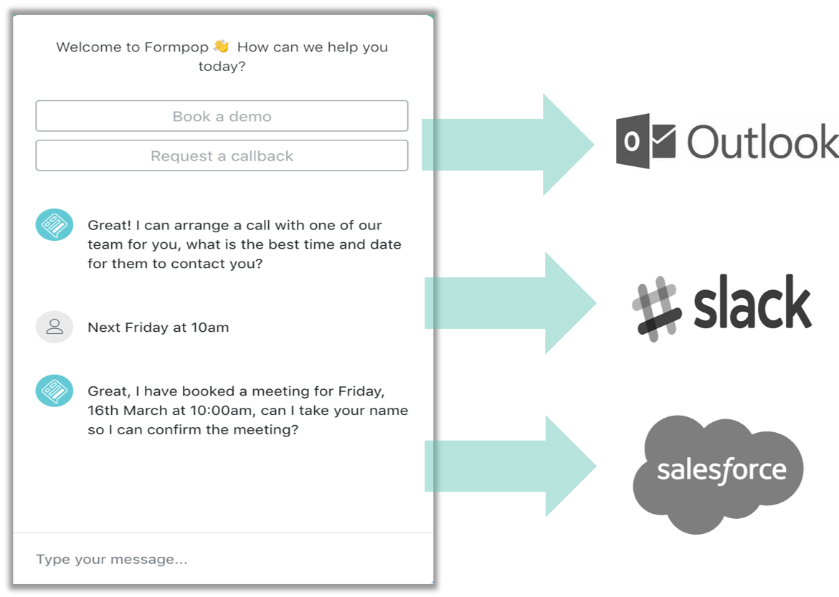

Inbound
An AI/NLP powered website ‘sales assistant’ to drive customer conversations
ACME replaces website forms to qualify leads and convert them on site
Books meetings, sends the visitor and the sales person an Outlook/Google invite

Slide 4
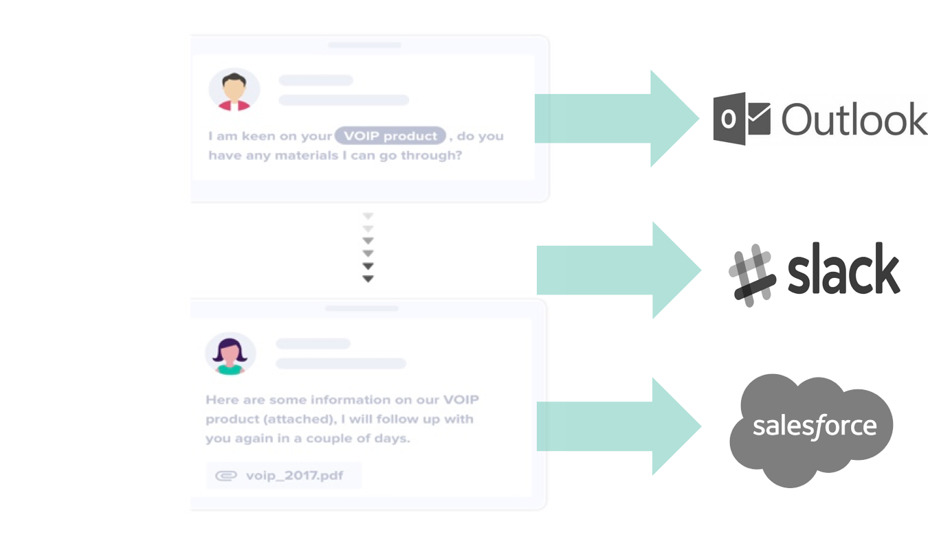
Outbound
The ACME Bus Dev Rep handles objections, qualifies and books meetings with prospects
Allows BDR’s to focus on cold calling instead of manually sending hundreds of emails each week
Integrates with Salesforce, Outlook, Gmail, Slack to book meetings and auto populate CRM systems

Slide 5
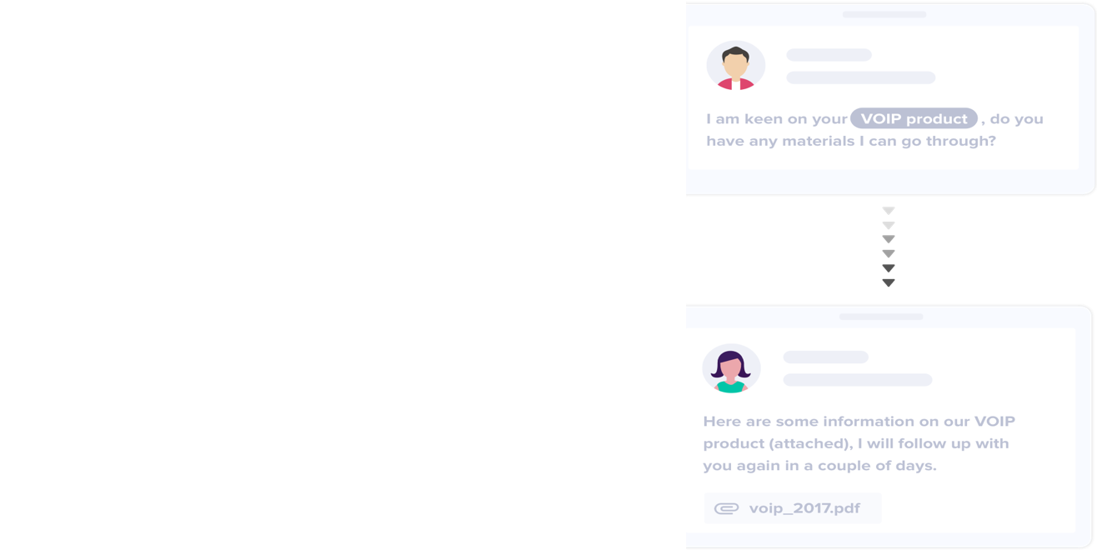
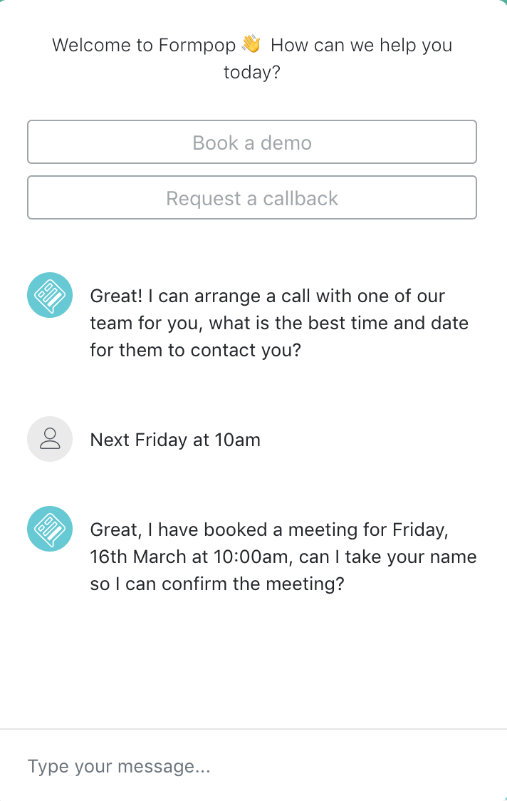
Solution
Inbound Leads
Sales Development as a Service: SDaaS
Natural Language Processing
Machine Learning
Sentiment Analysis
Outbound Leads

Slide 6
Progress to date

Slide 7
Metrics
Weekly registration increase of 11.25%
Register to active user conversion of 12%

Slide 8
Roadmap
Weekly registration increase of 11.25%
Register to active user conversion of 12%

Slide 9
Technology WHAT/HOW
Weekly registration increase of 11.25%
Register to active user conversion of 12%

Slide 10
Technology (WHY)
Weekly registration increase of 11.25%
Register to active user conversion of 12%

Slide 11
Hackathon
Weekly registration increase of 11.25%
Register to active user conversion of 12%

